Slide 1
BMD ENG 301Quantitative Systems Physiology (Nervous System)
Somatosensation
2022_v1
Professor Malcolm A. MacIver

Slide 2
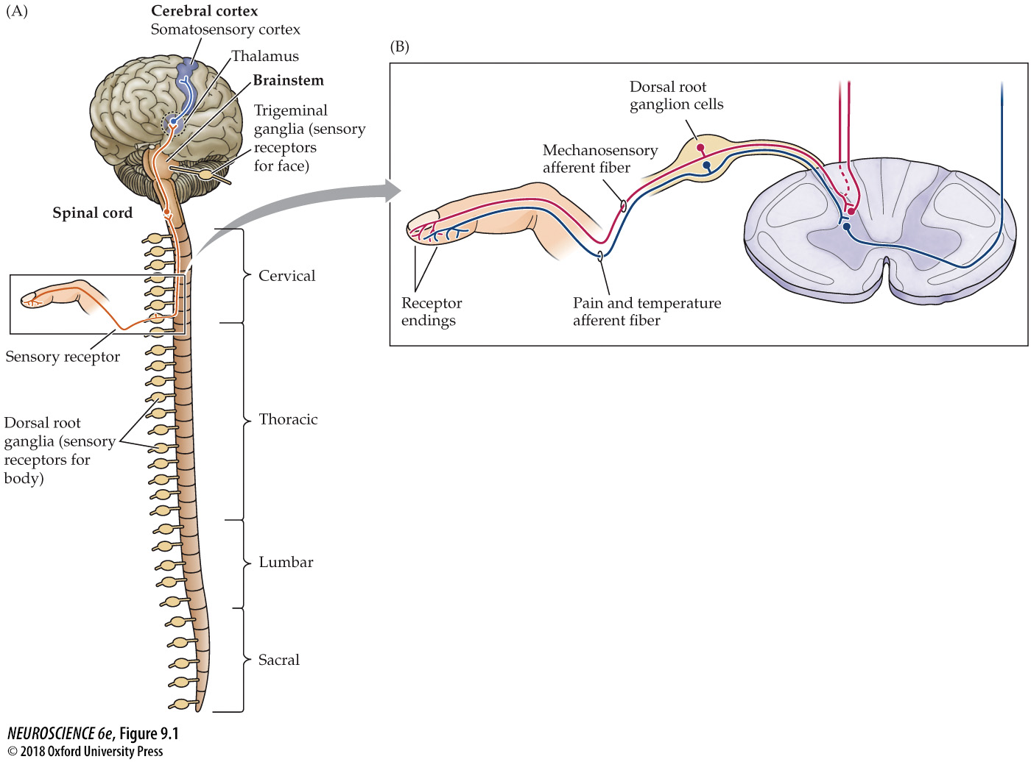
FIGURE 9.1 Somatosensory afferents convey information from the skin surface to central circuits
Notes:
FIGURE 9.1 Somatosensory afferents convey information from the skin surface to central circuits. (A) The cell bodies of somatosensory afferent fibers conveying information about the body reside in a series of dorsal root ganglia that lie along the spinal cord; those conveying information about the head are found primarily in the trigeminal ganglia. (B) Pseudounipolar neurons in the dorsal root ganglia give rise to peripheral processes that ramify within the skin (or muscles or joints) and central processes that synapse with neurons located in the spinal cord and at higher levels of the nervous system. The peripheral processes of mechanoreceptor afferents are encapsulated by specialized receptor cells; afferents carrying pain and temperature information terminate in the periphery as free endings.

Slide 3
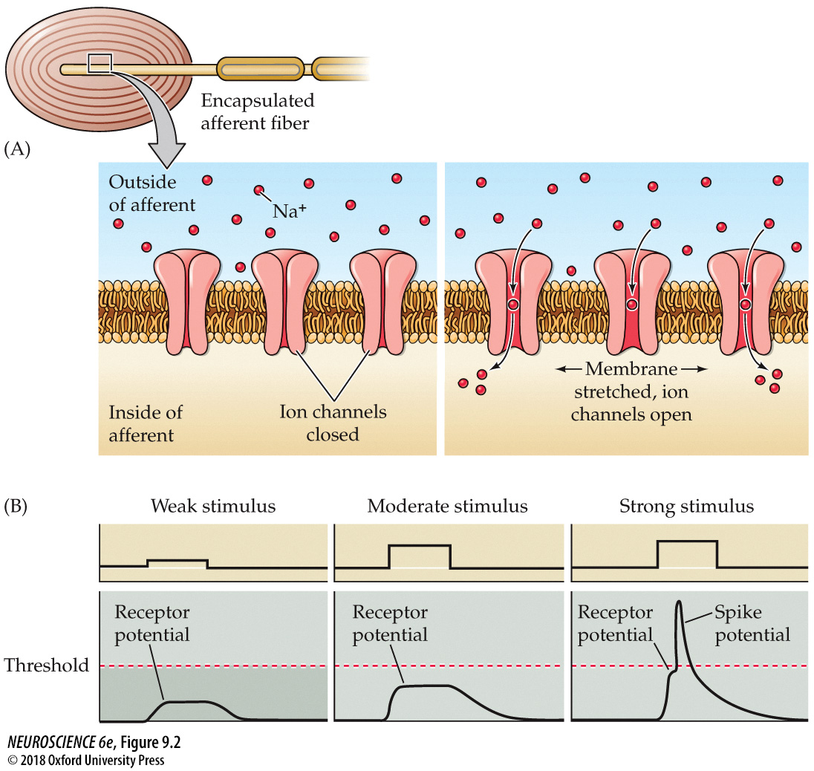
FIGURE 9.2 Transduction in a mechanosensory afferent
Notes:
FIGURE 9.2 Transduction in a mechanosensory afferent. The process is illustrated here for a Pacinian corpuscle. (A) Deformation of the capsule leads to a stretching of the membrane of the afferent fiber, increasing the probability of opening mechanotransduction channels in the membrane. (B) Opening of these cation channels leads to depolarization of the afferent fiber (receptor potential). If the afferent is sufficiently depolarized, an action potential is generated and propagates to central targets.

Slide 4
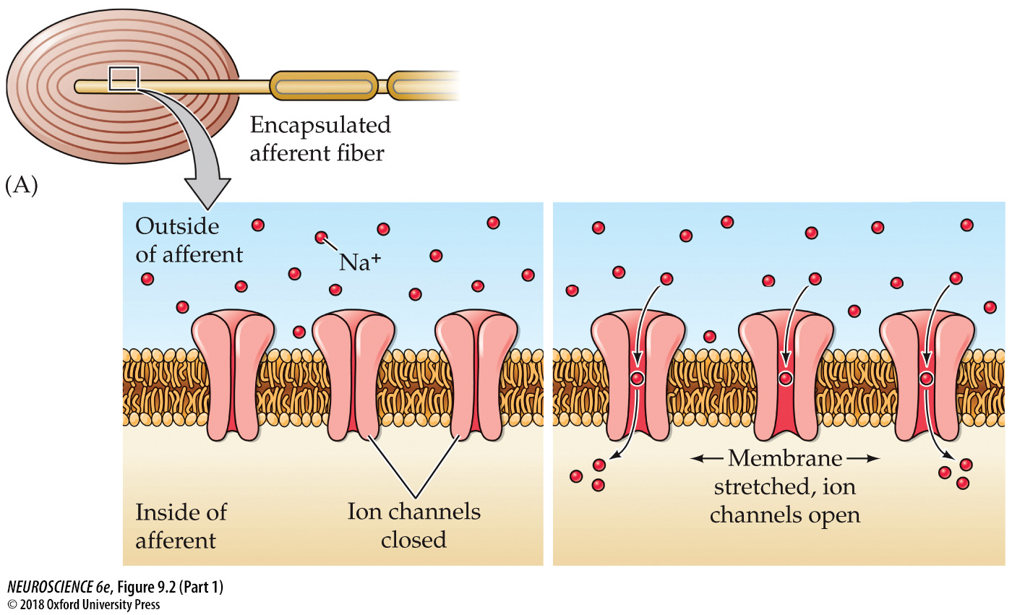
FIGURE 9.2 Transduction in a mechanosensory afferent (Part 1)
Notes:
FIGURE 9.2 Transduction in a mechanosensory afferent. The process is illustrated here for a Pacinian corpuscle. (A) Deformation of the capsule leads to a stretching of the membrane of the afferent fiber, increasing the probability of opening mechanotransduction channels in the membrane. (B) Opening of these cation channels leads to depolarization of the afferent fiber (receptor potential). If the afferent is sufficiently depolarized, an action potential is generated and propagates to central targets.

Slide 5
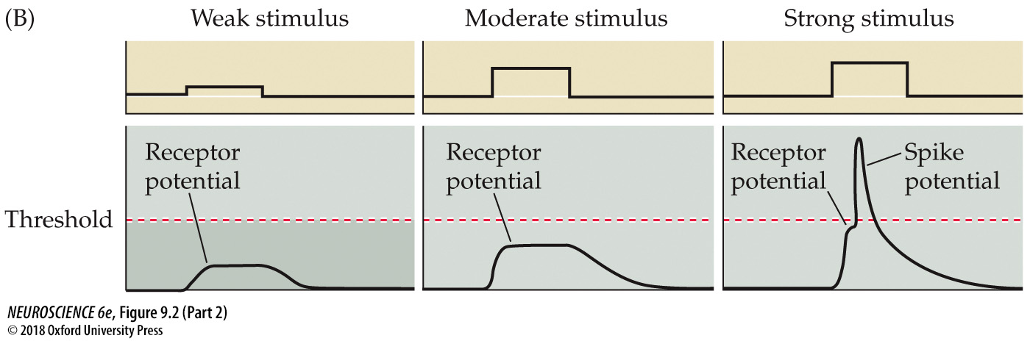
FIGURE 9.2 Transduction in a mechanosensory afferent (Part 2)
Notes:
FIGURE 9.2 Transduction in a mechanosensory afferent. The process is illustrated here for a Pacinian corpuscle. (A) Deformation of the capsule leads to a stretching of the membrane of the afferent fiber, increasing the probability of opening mechanotransduction channels in the membrane. (B) Opening of these cation channels leads to depolarization of the afferent fiber (receptor potential). If the afferent is sufficiently depolarized, an action potential is generated and propagates to central targets.

Slide 6
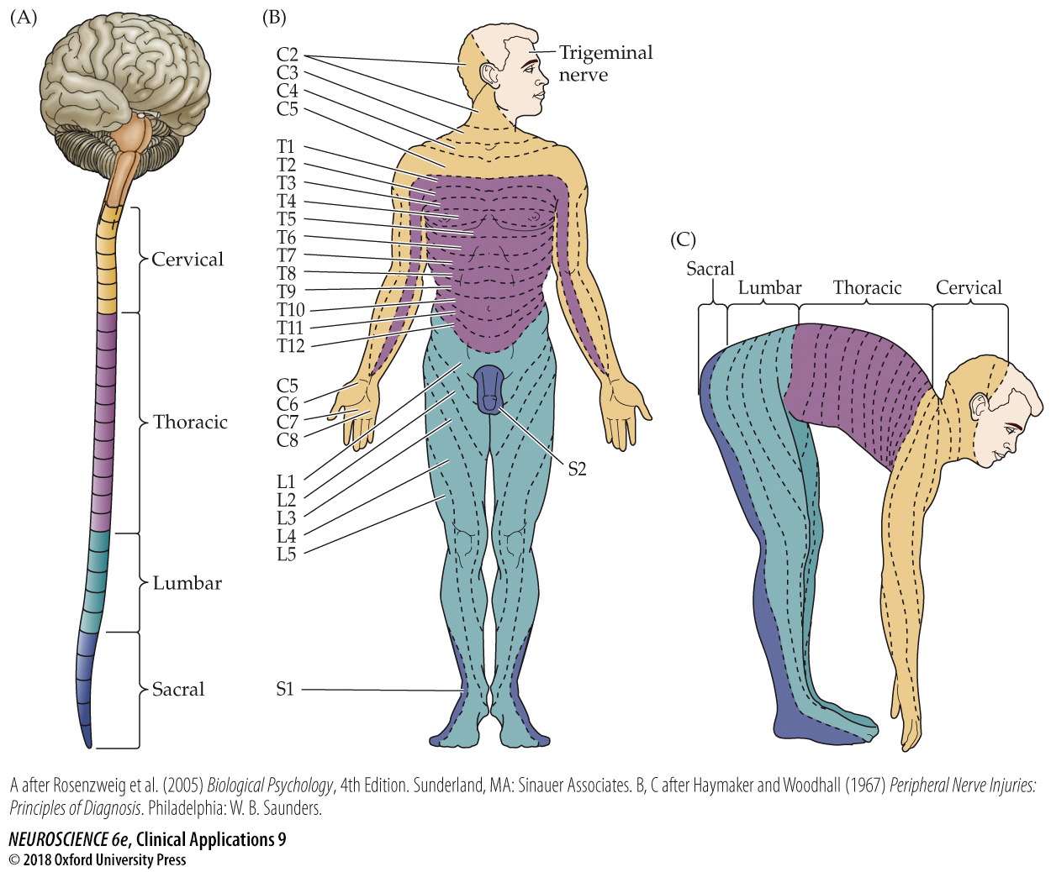
CLINICAL APPLICATIONS Dermatomes
Notes:
CLINICAL APPLICATIONS Dermatomes
The innervation arising from a single dorsal root ganglion and its spinal nerve is called a dermatome. The full set of sensory dermatomes is shown here for a typical adult. Knowledge of this arrangement is particularly important in defining the location of suspected spinal (and other) lesions. The numbers refer to the spinal segments by which each nerve is named. (A,C after Rosenzweig et al., 2005; Haymaker and Woodhall, 1967; B after Haymaker and Woodhall, 1967.)

Slide 7
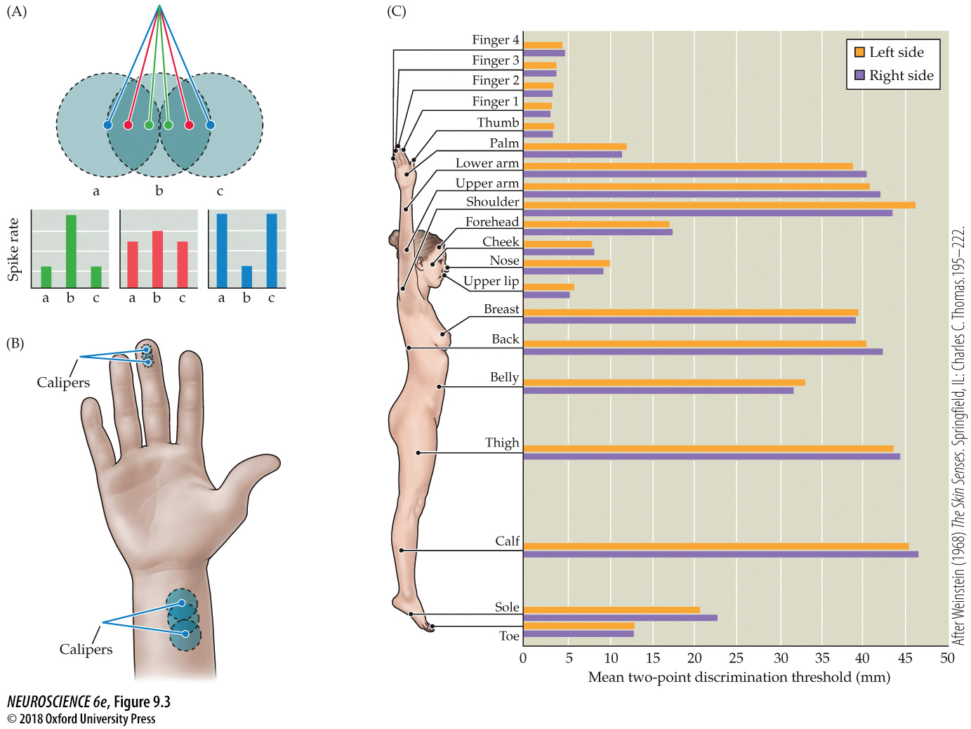
FIGURE 9.3 Receptive fields and the two-point discrimination threshold
Notes:
FIGURE 9.3 Receptive fields and the two-point discrimination threshold. (A) Patterns of activity in three mechanosensory afferent fibers with overlapping receptive fields a, b, and c on the skin surface. When two-point discrimination stimuli are closely spaced (green dots and histogram), there is a single focus of neural activity, with afferent b firing most actively. As the stimuli are moved farther apart (red dots and histogram), the activity in afferents a and c increases and the activity in b decreases. At some separation distance (blue dots and histogram), the activity in a and c exceeds that in b to such an extent that two discrete foci of stimulation can be identified. This differential pattern of activity forms the basis for the two-point discrimination threshold. Stimulation applied to the center of the receptive field tends to evoke stronger responses than stimuli applied at more eccentric locations within the receptive field (see Figure 1.14). (B) The two-point discrimination threshold in the fingers is much finer than that in the wrist because of differences in the sizes of afferent receptive fields—that is, the separation distance necessary to produce two distinct foci of neural activity in the population of afferents innervating the lower arm is much greater than that for the afferents innervating the fingertips. (C) Differences in the two-point discrimination threshold across the surface of the body. Somatic acuity is much higher in the fingers, toes, and face than in the arms, legs, or torso. (C after Weinstein, 1968.)

Slide 8
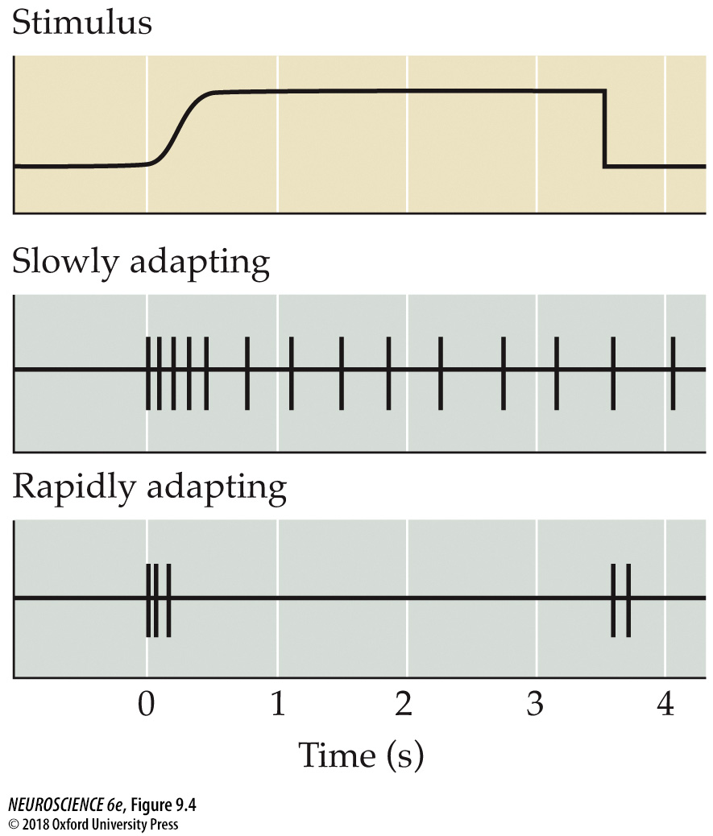
FIGURE 9.4 Slowly and rapidly adapting mechanoreceptors provide different information
Notes:
FIGURE 9.4 Slowly and rapidly adapting mechanoreceptors provide different information. Slowly adapting receptors continue responding to a stimulus, whereas rapidly adapting receptors respond only at the onset (and often the offset) of stimulation. These functional differences allow mechanoreceptors to provide information about both the static (via slowly adapting receptors) and dynamic (via rapidly adapting receptors) qualities of a stimulus.

Slide 9
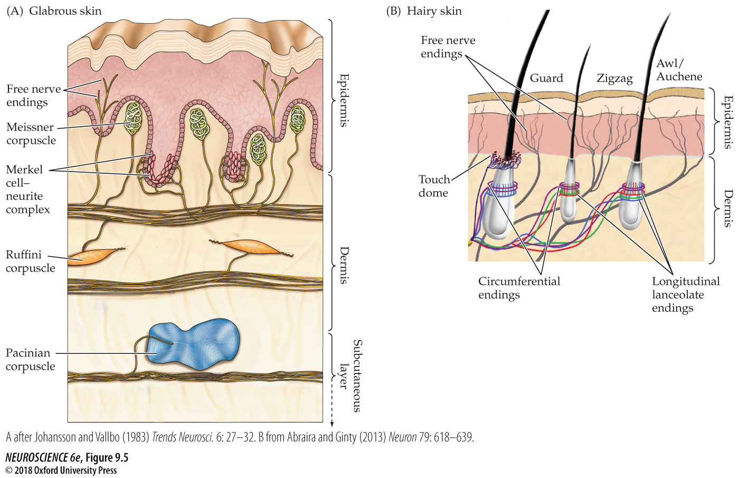
FIGURE 9.5 The skin harbors a variety of morphologically distinct mechanoreceptors
Notes:
FIGURE 9.5 The skin harbors a variety of morphologically distinct mechanoreceptors. (A) This diagram represents the smooth, hairless (glabrous) skin of the fingertip. Table 9.2 summarizes the major characteristics of the various receptor types found in glabrous skin. (B) In hairy skin, tactile stimuli are transduced through a variety of mechanosensory afferents innervating different types of hair follicles. These arrangements are best known in mouse skin (illustrated here); see text for details. Similar mechanosensory afferents are believed to innervate hair follicles in human skin. (A after Johansson and Vallbo, 1983; B from Abraira and Ginty, 2013.)

Slide 10
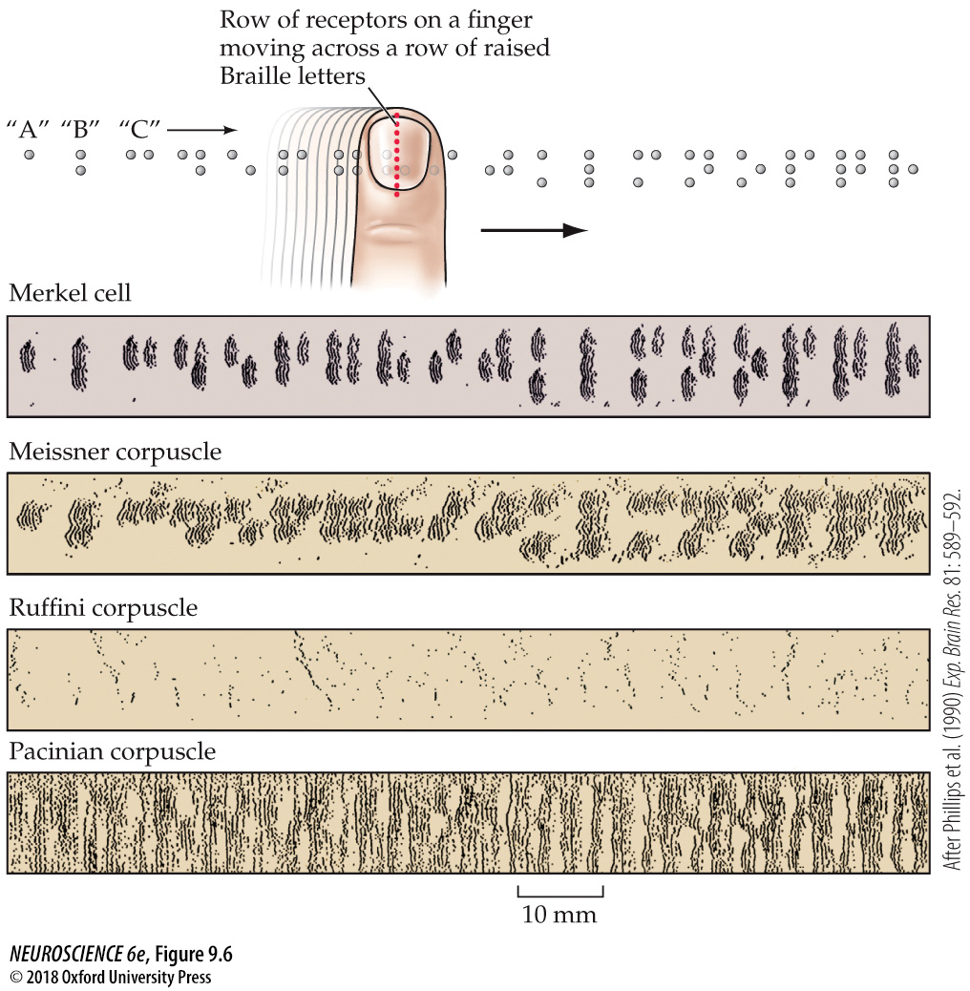
FIGURE 9.6 Simulation of activity patterns in different mechanosensory afferents in the fingertip
Notes:
FIGURE 9.6 Simulation of activity patterns in different mechanosensory afferents in the fingertip. Each dot in the response records represents an action potential recorded from a single mechanosensory afferent fiber innervating the human finger as it moves across a row of Braille type. A horizontal line of dots in the raster plot represents the pattern of activity in the afferent as a result of moving the pattern from left to right across the finger. The position of the pattern (relative to the tip of the finger) was then displaced by a small distance, and the pattern was once again moved across the finger. Repeating this pattern multiple times produces a record that simulates the pattern of activity that would arise in a population of afferents whose receptive fields lie along a line in the fingertip (red dots). Only slowly adapting Merkel cell afferents (top panel) provide a high-fidelity representation of the Braille pattern—that is, the individual Braille dots can be distinguished only in the pattern of Merkel afferent neural activity. (After Phillips et al., 1990.)

Slide 11
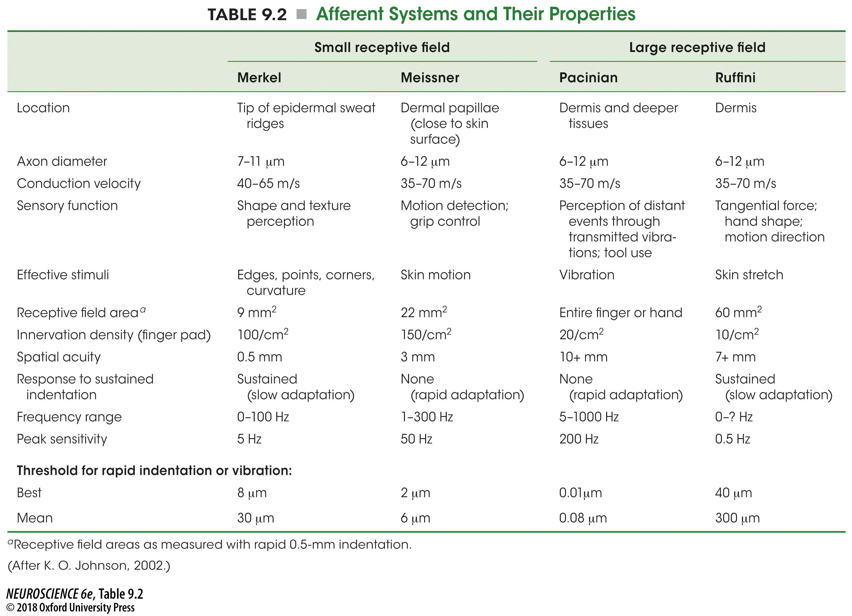
TABLE 9.2 Afferent Systems and Their Properties
Notes:
TABLE 9.2 Afferent Systems and Their Properties

Slide 12
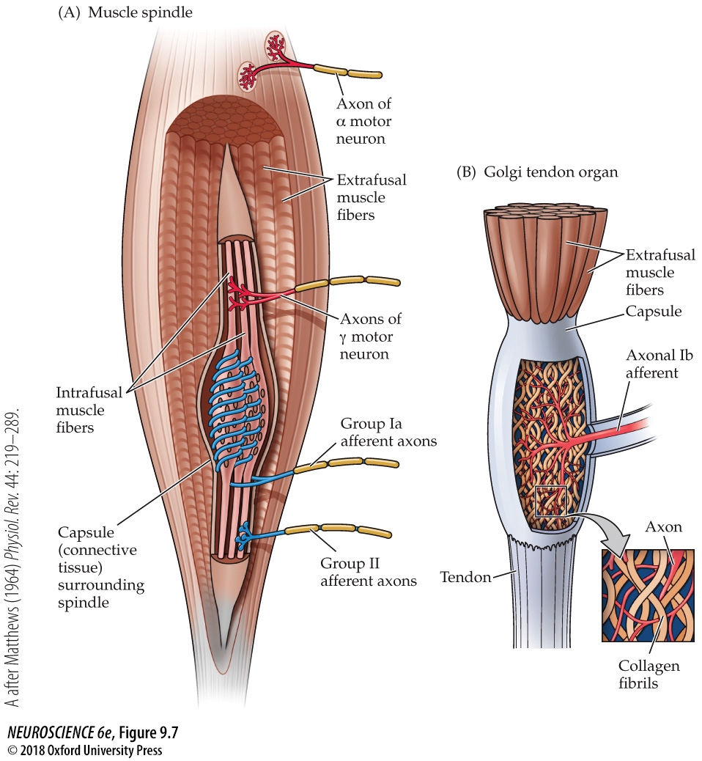
FIGURE 9.7 Proprioceptors in the musculoskeletal system
Notes:
FIGURE 9.7 Proprioceptors in the musculoskeletal system. These “self-receptors” provide information about the position of the limbs and other body parts in space. (A) A muscle spindle and several extrafusal muscle fibers. The specialized intrafusal muscle fibers of the spindle are surrounded by a capsule of connective tissue. (B) Golgi tendon organs are low-threshold mechanoreceptors found in tendons; they provide information about changes in muscle tension. (A after Matthews, 1964.)

Slide 13
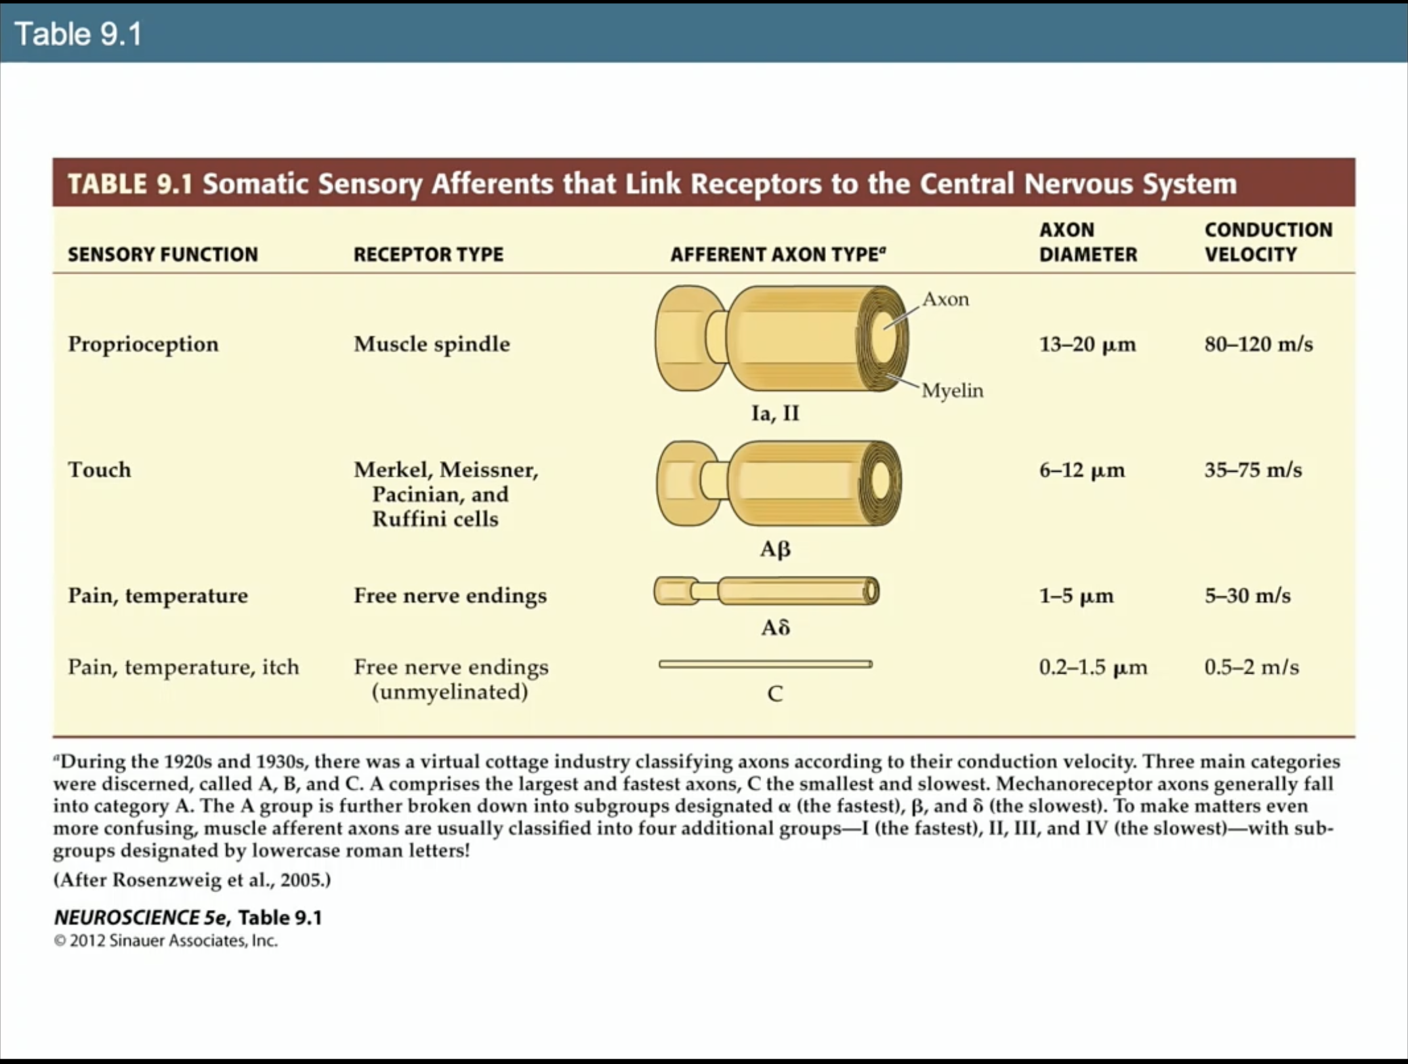

Slide 14
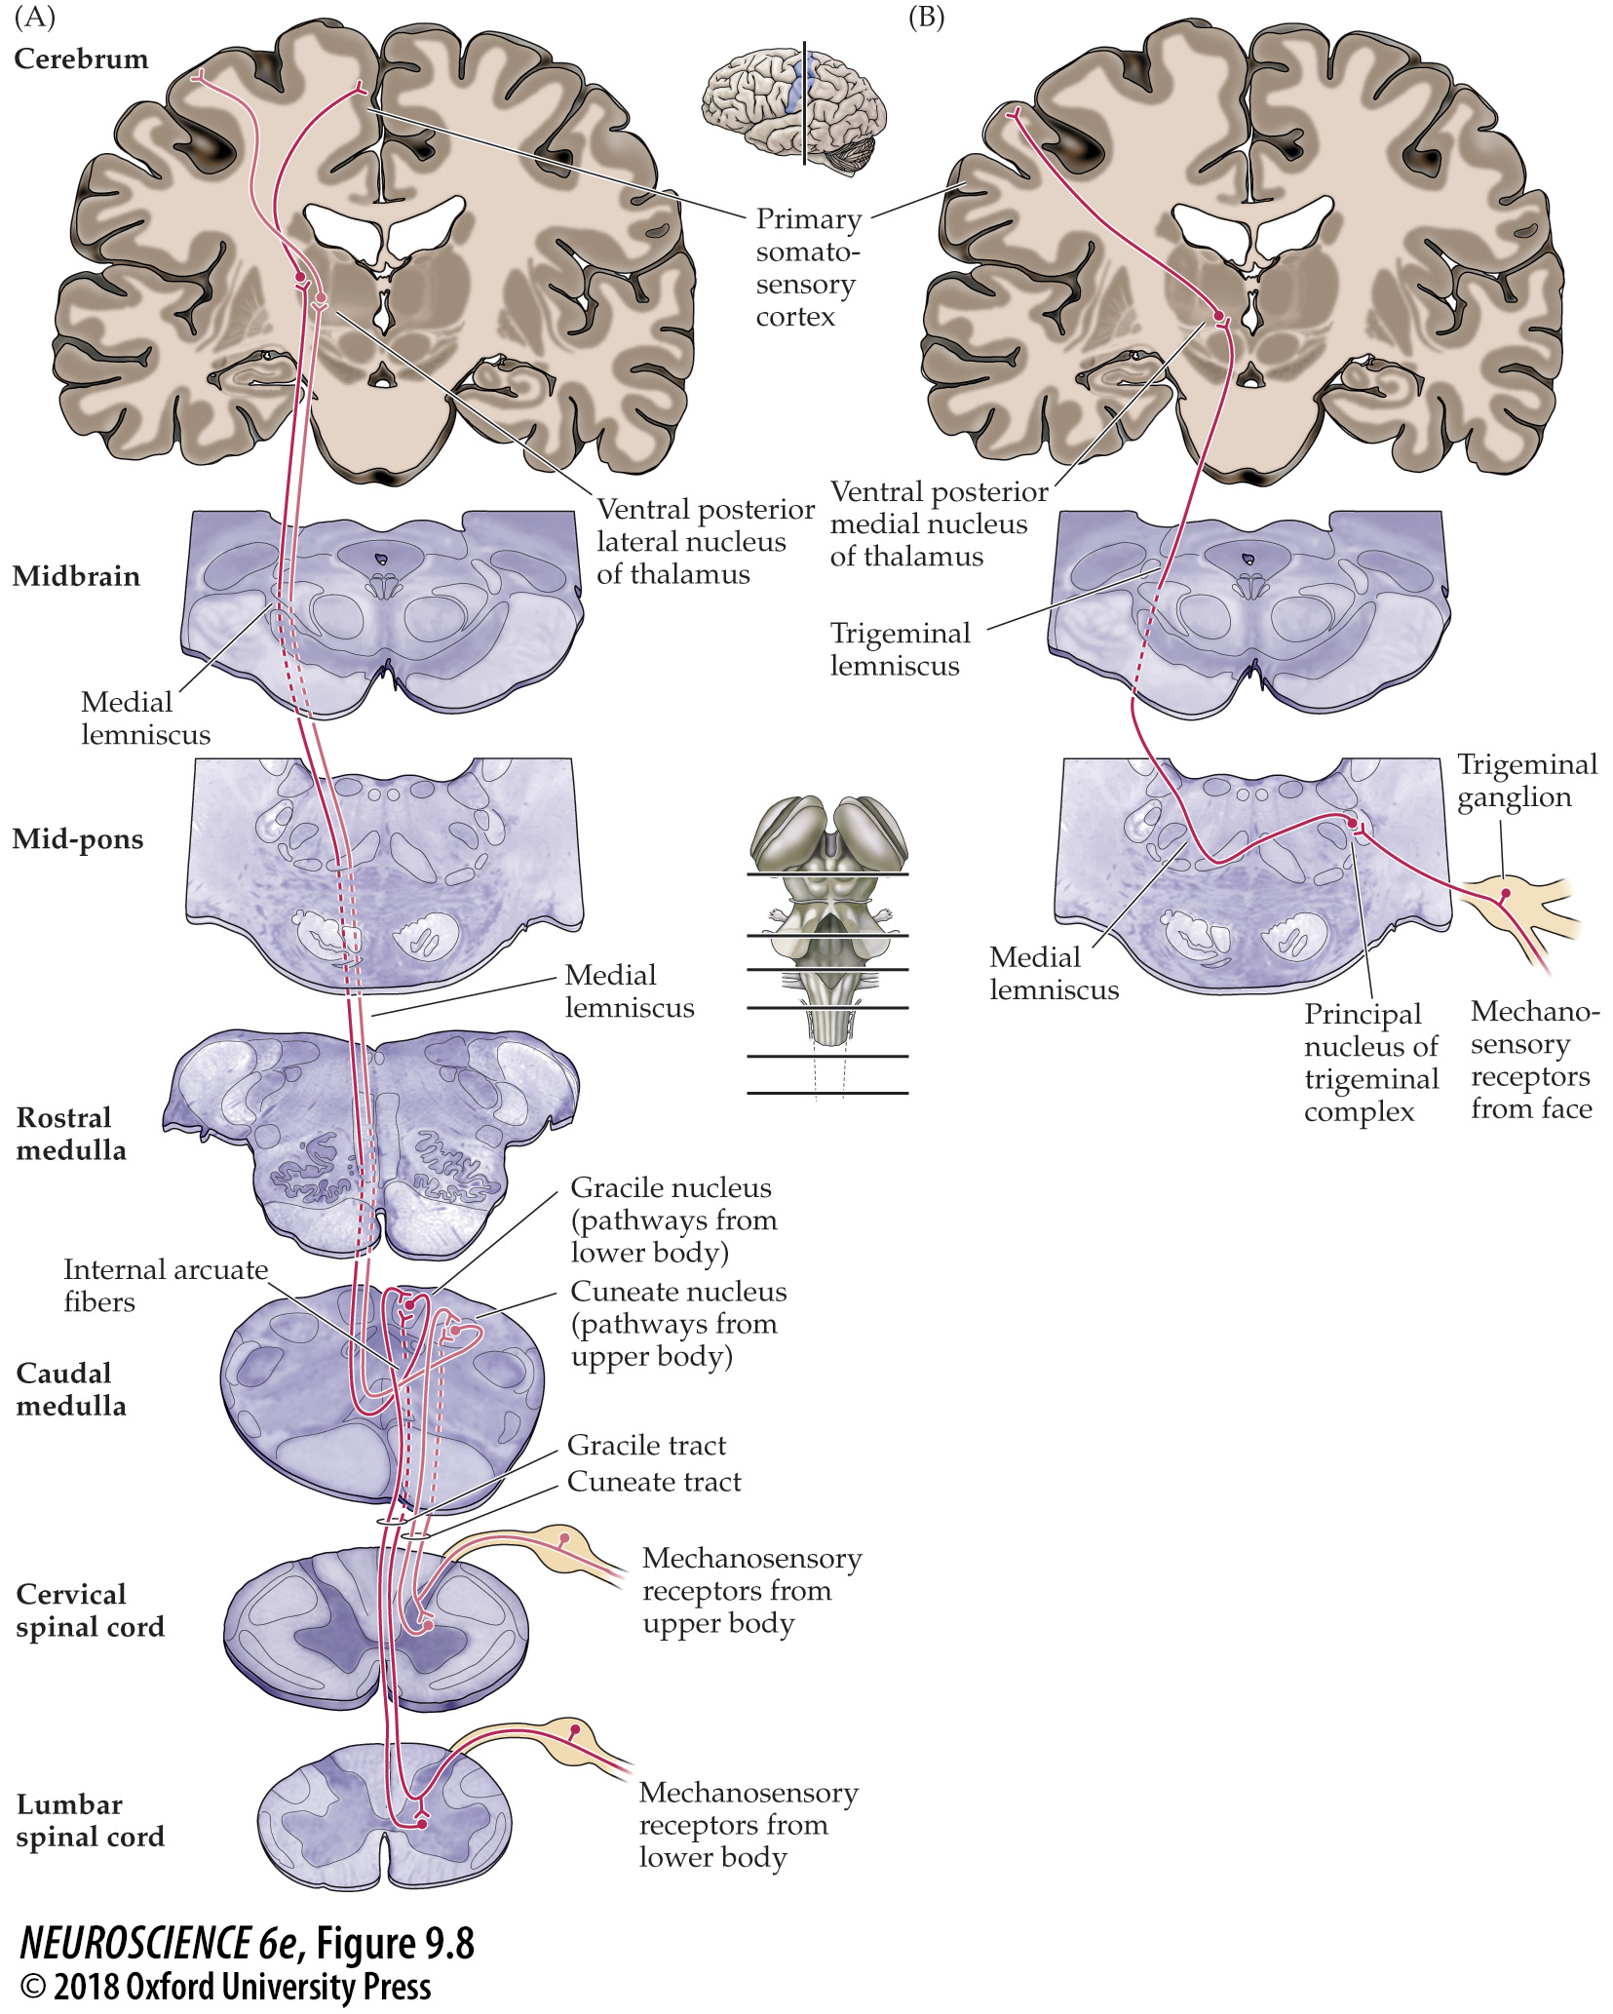
FIGURE 9.8 The main touch pathways
Notes:
FIGURE 9.8 The main touch pathways. (A) The dorsal column–medial lemniscal pathway carries mechanosensory information from the posterior third of the head and the rest of the body. (B) The trigeminal portion of the mechanosensory system carries similar information from the face.

Slide 15
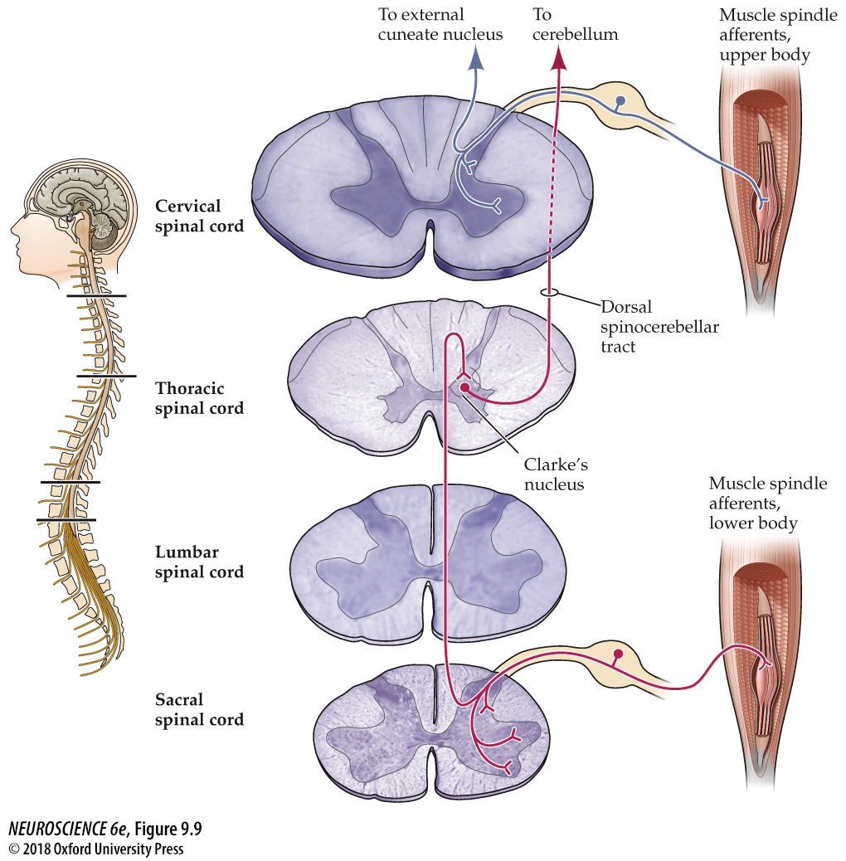
FIGURE 9.9 Proprioceptive pathways for the upper and lower body
Notes:
FIGURE 9.9 Proprioceptive pathways for the upper and lower body. Proprioceptive afferents for the lower part of the body synapse on neurons in the dorsal and ventral horn of the spinal cord and on neurons in Clarke’s nucleus. Neurons in Clarke’s nucleus send their axons via the dorsal spinocerebellar tract to the cerebellum, with a collateral to the dorsal column nuclei. Proprioceptive afferents for the upper body also have synapses in the dorsal and ventral horns, but then ascend via the dorsal column to the dorsal column nuclei; the external cuneate nucleus, in turn, relays signals to the cerebellum. Proprioceptive target neurons in the dorsal column nuclei send their axons across the midline and ascend through the medial lemniscus to the ventral posterior nucleus (see Figure 9.8).

Slide 16
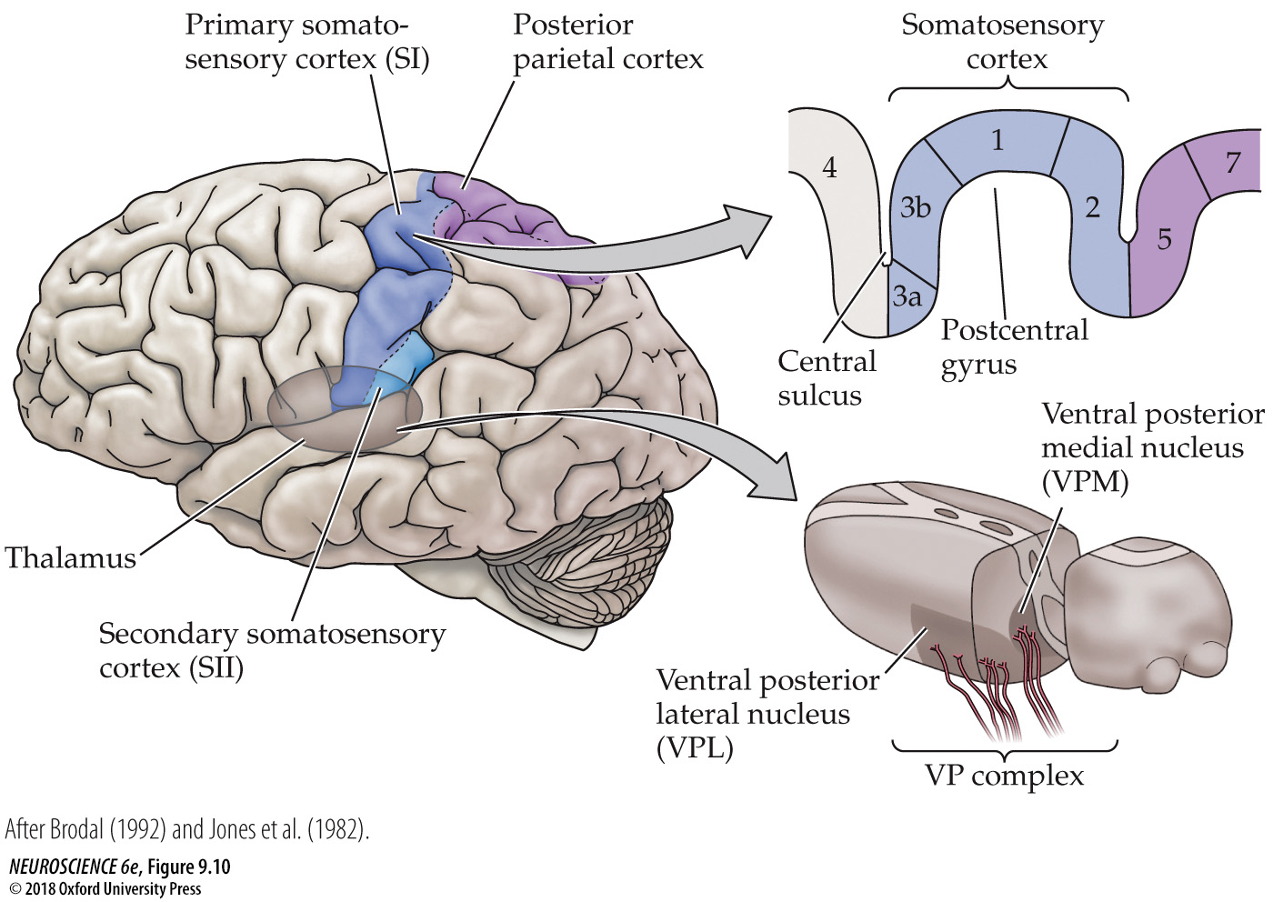
FIGURE 9.10 Somatosensory portions of the thalamus and their cortical targets in the postcentral gyrus
Notes:
FIGURE 9.10 Somatosensory portions of the thalamus and their cortical targets in the postcentral gyrus. The ventral posterior nuclear complex comprises the VPM, which relays somatosensory information carried by the trigeminal system from the face, and the VPL, which relays somatosensory information from the rest of the body. The diagram at the upper right shows the organization of the primary somatosensory cortex in the postcentral gyrus, shown here in a section cutting across the gyrus from anterior to posterior. (After Brodal, 1992 and Jones et al., 1982.)

